Slide 1
Introduction to Programming(2) : Variables
컴파스
최병재
06.13

Slide 2
Programming Development
“Programs were not built in a day”; there is no program perfect when is first released
When developing a program, there are many “Development cycles”
Each cycle consists of 4 stages:
- Idea
- Design
- Program
- Evaluate

Slide 3
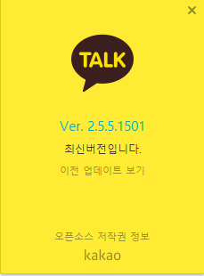
Programming Development
When one cycle ends, we usually say the program is upgraded, and add 0.1 or 0.0.1 to the current version(version up)
For example, Kakaotalk has seen
1 very major improvement from 1.0.0(first released version),
and 5 major improvements from 2.0.0
5 minor improvements from 2.5.0
1501 very minor improvements from 2.5.5.0
-> 1501 * 5 * 5 * 1
More than 20,000 cycles!

Slide 4
Programming Development
In other words, a program needs continuous maintenance(typically >3 years for “AAA programs”); there should be enough funds and people
But government aids only last for a short period… that’s one of the reasons many start-ups shut down after 1 or 2 years.
Further discussions on programming development.

Slide 5
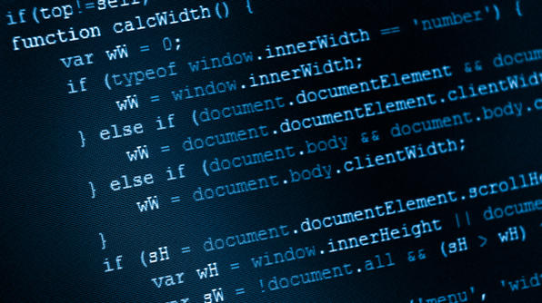
Comment
Everyone hates reading others’ codes ; It is too hard to understand
????
Even the one who programmed the code often has difficulty understanding his own code.

Slide 6
Comment
You need to explain the meaning, the intention, and problems implied in the code
In other words, you have to leave a “comment” in the code
In computer science, comment(주석) is a programmer-readable explanation or annotation in the source code of a computer program

Slide 7
Comment
In Python, you can write a comment by using #
Of course, computer ignores comments
>>> print("주석을 컴퓨터는 무시합니다") # 이렇게요!
주석을 컴퓨터는 무시합니다

Slide 8
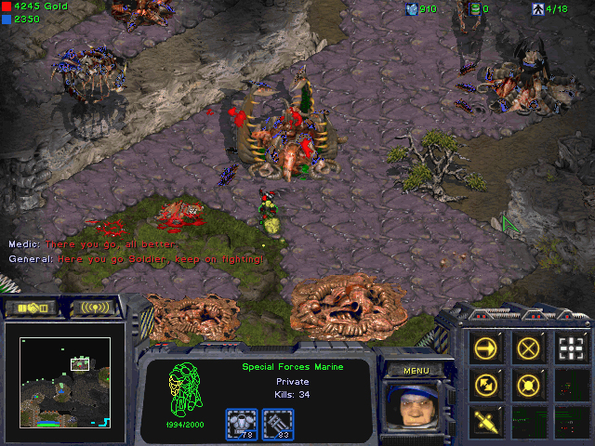
What are Variables?
Assume you are a programmer of Starcraft
In Starcraft, there is a unit named Marine

Slide 9
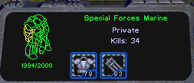
Hit Point (HP)
Name(Marine)

Slide 10
What are Variables?
A Marine should have HP(Hit Point), which varies 0 to 40(value)
He has full 40 points when he is recruited. When he is attacked by enemies, his HP decreases.
At 0 HP, he dies.
The Question is : How can we program marine?
You need to “store” exact HP of a marine at a certain point, and change stored HP when attacked.
By applying the idea of variable, you can create a marine.
A variable(변수) is the name that refers to a value

Slide 11
Variables
There are only 3 things to remember : Declaring, Assignment, and Calling
Declaring means you “Declare(선언)” to use a specific variable.
Assignment(할당) means you assign a specific value to a specific variable.
Calling means you Call(호출) a variable to use/change it’s value

Slide 12
Examples
>>> a = 2 # Declare “a” and assign 2
>>> a # Call a
>>> marine = 10 # Declare “marine” and assign 10, 10 is marine’s HP(value)
>>> marine # Call marine
>>> a = 3
>>> a = a – 1 # Call a and add -1 to value of a

Slide 13
What happens inside of a computer?
>>> a = 2
>>> a+2
4
When we type this,
What happens inside of a computer?

Slide 14
Computer Memory
Declaring
a
Allocating(할당) a free space to variable a(labelling)
Assigning
2
a ,
2
Saving value 2 to space of variable a

Slide 15
Calling
a , 2
Call value of variable a(2) to CPU
So that CPU can perform operations on a value
2
Processor
( CPU )
2 + 2 = ?

Slide 16
Returning
Our eye
4
Monitor
a
2->4
Returning(반환) a result to memory
Re-assigning a value
4
Processor
( CPU )
4!!!!!!

Slide 17
What is “lag”?
a
b
c
d
e
f
Too many variables in memory…
g
We need to wait!
Till processes using variables a, b, c are terminated.
Processor
( CPU )
??????
this is just one of the many explanations that describes why lag occurs.

Slide 18
Operators
Operators are special tokens that represent computations like addition, multiplication and division
Without operators, Variables are useless; you have to manipulate variables with operators(or functions)!
+,-,*,/,**, //, %.....

Slide 19
Operators
>>> "생거진천" + "너무좋아"
'생거진천너무좋아'
>>> "교육은" - "싫어"
Traceback (most recent call last):
File "<pyshell#8>", line 1, in <module>
"교육은" - "싫어"
TypeError: unsupported operand type(s) for -: 'str' and 'str'

Slide 20
Types
Every value has its own type
Only variables with the same type can be operated(added/multiplied/…) together
You can use the command “type” to identify what type a variable is.
For example:

Slide 21
Types
>>> type(3)
<class 'int'>
>>> type(3.14159)
<class 'float'>
>>> type("이게 뭘까요")
<class 'str'>
>>> a=3
>>> type(a)
<class 'int'>

Slide 22
The Second Program
Let’s make our second program : “the circle area calculator”
It computes the area of a circle with certain radius, and print results as follows:
>>>원의 반지름의 길이를 입력하세요: 1
주어진 원의 반지름은 1입니다
주어진 원의 넓이는 3.14159입니다

Slide 23
radius = input("원의 반지름의 길이를 입력하세요: ")
print("주어진 원의 반지름은 " + str(radius) + "입니다")
pi = 3.14159
radius_float = float(radius)
area = pi * radius_float * radius_float
print("주어진 원의 넓이는 " + str(area) + "입니다")

